Slide 1

FALL 2023
MIS 381N
Information management
Lecture 4
August 30th 2023
Prashant D. Joshi
UT McCombs School of Business (MSBA), The University of Texas at Austin

Slide 2

Objectives
Data Management: ER Modelling and Normalization
Class Participation on Canvas
Fidelity model presentation
ER Modeling – relationships, notations and best practices
Normalization
In-class practice
Questions and discussion

Slide 3
What questions may I answer before we begin …
All questions are good questions

Slide 4
Housekeeping
Participation Credit on Canvas “Take Aways and Reflection on Week 2”
Assignment coming up soon; look out for it on Canvas. I will also send email to the class regarding it once it is on Canvas
Next week Monday, Sept 4th, no class

Slide 5
What questions may I answer before we begin …
All questions are good questions

Slide 6
Recap of important concepts
A “model” is a representation of the real world and is built for a specific purpose
An “entity-relationship” model is a model of the data and the rules that govern the data within a business enterprise
An entity corresponds to a physical thing in the real-world. Examples: Student, Building, Machine, …
Attributes describe an entity. Example: A Student may be described by their name, gender, and date of birth.
Relationship describe how an entity “relates” to other entities. Example: A student resides in a building and is trained to operate a machine.
An entity maps to a table and attributes map to columns
Each table should have at least one column that has a unique value across all rows – one such column is designated as a primary key (other unique valued columns are secondary keys)
When two entities are related, the primary key from one of the corresponding tables is a foreign key in the other table

Slide 7
Fidelity Model Presentations

Slide 8
Fidelity high-level logical model
Person
Account
Asset
PersonId(PK)
AccountId(PK)
PersonId(FK)
AssetIId(PK)
AccountId(FK)
ATypeID(FK)
1
has
N
1
has
N
N
categorizes
1
1
1
has
has
N
N
AssetType
Transaction
AssetValue
ATypeID(PK)
TransactionId(PK)
AccountId(FK)
AvId(PK)
AssetId(FK)

Slide 9
Relationships & Notations

Slide 10
Types (Cardinality) of Relationships
One to One
One to Many
Many to Many
Zero/One to One
Zero/One to Many

Slide 11
Types (Cardinality) of Relationships
One to One: One student can occupy only one chair at a given time
Student
OccupiedChair
StudentIId(PK)
OccupiedChairID(PK)
StudentId(FK)
1
Sits on
1
Zero/One to One: One student can occupy only one chair at a given time but all students don’t have to be seated
Student
OccupiedChair
StudentIId(PK)
OccupiedChairID(PK)
StudentId(FK)
0/1
Sits on
1

Slide 12
Types (Cardinality) of Relationships
One to Many: An instructor can teach many courses in a semester
Instructor
Course
InstructorId(PK)
CourseID(PK)
InstructorId(FK)
1
Can teach
N
Zero/One to One: An instructor can teach many courses in a semester, but some instructors don’t teach any course
Instructor
Course
InstructorId(PK)
CourseID(PK)
InstructorId(FK)
0/1
Can teach
N

Slide 13
Types (Cardinality) of Relationships
Many to Many: A student can sign up for many courses and a course can be offered to many students
Student
Course
StudentId(PK)
CourseId(FK)
CourseID(PK)
StudentId(FK)
1
Can enroll
N
N
Can be offered to
1

Slide 14
Modeling Notation – Preference
Space for attributes
Noun. Singular, No spaces, Capital letter at the start of each word or separate words with a dash
Keys
Uniquely identifies an entity instance
Primary Key indicated as (PK) next to the name of the attribute
Foreign Key indicated as (FK) next to the name of the attribute
EntityName
For modeling attributes can be atomic, composite, or multi-valued. For implementation they should be atomic.
Entity1
Entity2
1
IsRelatedTo
N
Verb. Capital start letter. Arrow in direction where verb makes sense.
Cardinality indicated at the ends of the line.

Slide 15
Modeling Notation – Crow’s Foot
Exactly One
Zero or One
Zero, One or More
One or More

Slide 16
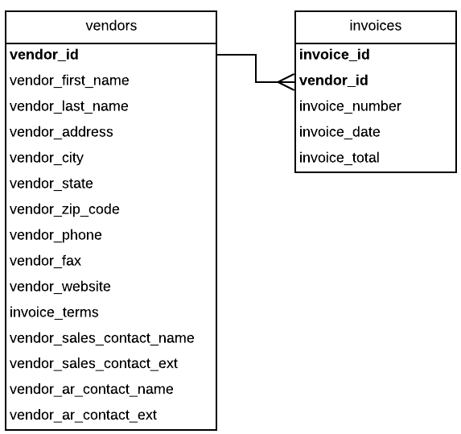
Relational Integrity
Deleting a row from primary key table: If the foreign key table contains one or more rows related to the deleted row
Inserting a row in the foreign key table: If the foreign key value doesn’t have a matching primary key value in the related table (Each non-null value you insert into a foreign key column must be equal to some value in the corresponding parent key of the parent table)
Updating the value of a foreign key: If the new foreign key value doesn’t have a matching primary key value in the related table
Updating the value of a primary key: If the foreign key table contains one or more rows related to the row that’s changed

Slide 17
Normalization

Slide 18
Normalization benefits and costs
Reduce redundant data
Improve data quality
Increase the questions that can be answered
Make the model easier to read and understand
Normalization results in more tables
Sometimes this leads to
A model that is harder to read & understand
A database with degraded performance

Slide 19
Normalization Forms
There are seven normalization forms. The first three are considered critical and most designers stop after that because the costs can outweigh the benefits.
First Normal Form (1NF) – The value stored at the intersection of each row and column must be a scalar value, and a table must not contain any repeating columns.
Second Normal Form (2NF) – The primary key should be non-composite and every non-key column must depend on the entire primary key.
Third Normal Form (3NF) – Every non-key column must depend only on the primary key

Slide 20
Initial Design
Discussion Questions
How does this affect reads?
e.g. Count of registered courses
e.g. Sum of credits
How does this affect adds
e.g. New courses
How does this affect updates
e.g. Credits for a course
How does this affect deletes
e.g. Delete course
FirstName | LastName | StreetNumberAndAddress | RegisteredCourses | CourseCredits
John | Doe | 123 Main St. | MIS325, MIS304 | 3,3
Jane | Doe | 123 Valley Rd. | MIS304, MIS212 | 3,2
John | Doe | 123 Valley Rd | MIS325, MIS212 | 3,2

Slide 21
First Normal Form (1NF)
FirstName | LastName | StreetNumberAndAddress | RegisteredCourses | CourseCredits
John | Doe | 123 Main St. | MIS325, MIS304 | 3,3
Jane | Doe | 123 Valley Rd. | MIS304, MIS212 | 3,2
John | Doe | 123 Valley Rd | MIS325, MIS212 | 3,2
1NF Rule:
Each row is unique (✔️)
Each cell contains a single scalar value
First Normal Form (1NF) – The value stored at the intersection of each row and column must be a scalar value, and a table must not contain any repeating columns.

Slide 22
First Normal Form (1NF)
First Name | Last Name | StreetNumberAndAddress | RegisteredCourses | CourseCredits
John | Doe | 123 Main St. | MIS325, MIS304 | 3,3
Jane | Doe | 123 Valley Rd. | MIS304, MIS212 | 3,2
John | Doe | 123 Valley Rd | MIS325, MIS212 | 3,2
FirstName | Last Name | StreetNumberAndAddress | RegisteredCourse | CourseCredits
John | Doe | 123 Main St. | MIS325 | 3
John | Doe | 123 Main St. | MIS304 | 3
Jane | Doe | 123 Valley Rd. | MIS304 | 3
Jane | Doe | 123 Valley Rd. | MIS212 | 2
John | Doe | 123 Valley Rd | MIS325 | 3
John | Doe | 123 Valley Rd | MIS212 | 2
1NF Rule:
Each row is unique (✔️)
Each cell contains a single scalar value (✔️)

Slide 23
Second Normal Form (2NF)
FirstName | Last Name | StreetNumberAndAddress | RegisteredCourse | CourseCredits
John | Doe | 123 Main St. | MIS325 | 3
John | Doe | 123 Main St. | MIS304 | 3
Jane | Doe | 123 Valley Rd. | MIS304 | 3
Jane | Doe | 123 Valley Rd. | MIS212 | 2
John | Doe | 123 Valley Rd | MIS325 | 3
John | Doe | 123 Valley Rd | MIS212 | 2
2NF Rule:
1NF is true (✔️)
Primary key is not composite
All non-key fields depend on the primary key
Second Normal Form (2NF) – The primary key should be non-composite and every non-key column must depend on the entire primary key.

Slide 24
Second Normal Form (2NF)
StudentId | First Name | Last Name | StreetNumberAndAddress | RegisteredCourse | CourseCredits
001 | John | Doe | 123 Main St. | MIS325 | 3
001 | John | Doe | 123 Main St. | MIS304 | 3
002 | Jane | Doe | 123 Valley Rd. | MIS304 | 3
002 | Jane | Doe | 123 Valley Rd. | MIS212 | 2
003 | John | Doe | 123 Valley Rd | MIS325 | 3
003 | John | Doe | 123 Valley Rd | MIS212 | 2
2NF Rule:
1NF is true (✔️)
Primary key is not composite (✔️)
All non-key fields depend on the primary key

Slide 25
Second Normal Form (2NF)
Student Id | First Name | Last Name | StreetNumberAndAddress
001 | John | Doe | 123 Main St.
002 | Jane | Doe | 123 Valley Rd.
003 | John | Doe | 123 Valley Rd
Student Id | RegisteredCourse | CourseCredits
001 | MIS325 | 3
001 | MIS304 | 3
002 | MIS304 | 3
002 | MIS212 | 2
003 | MIS325 | 3
003 | MIS212 | 2
2NF Rule:
1NF is true (✔️)
Primary key is not composite (✔️)
All non-key fields depend on the primary key (✔️)

Slide 26
Third Normal Form (3NF)
Student Id | RegisteredCourse | CourseCredits
001 | MIS325 | 3
001 | MIS304 | 3
002 | MIS304 | 3
002 | MIS212 | 2
003 | MIS325 | 3
003 | MIS212 | 2
Student Id | First Name | Last Name | StreetNumberAndAddress
001 | John | Doe | 123 Main St.
002 | Jane | Doe | 123 Valley Rd.
003 | John | Doe | 123 Valley Rd
3NF Rule:
2NF is true (✔️)
Changing one non-key field should not require changing any other non-key field
The third normal form requires that all columns in a relational table are dependent only upon the primary key. (transitive dependency frowned upon)

Slide 27
Third Normal Form (3NF)
Student Id | First Name | Last Name | StreetNumberAndAddress
001 | John | Doe | 123 Main St.
002 | Jane | Doe | 123 Valley Rd.
003 | John | Doe | 123 Valley Rd
Student Id | RegisteredCourseId
001 | 001
001 | 002
002 | 002
002 | 003
003 | 001
003 | 003
CourseId | CourseName | CourseCredits
001 | MIS325 | 3
002 | MIS304 | 3
003 | MIS212 | 2
3NF Rule:
2NF is true (✔️)
Changing one non-key field should not require changing any other non-key field (✔️)

Slide 28
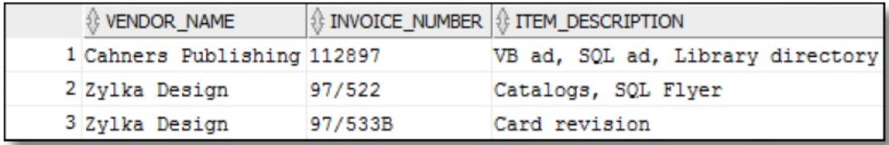

Another Example – Initial Design

Slide 29
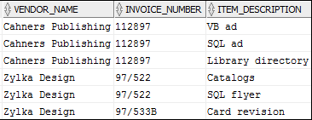
Normalization – First Normal Form
1NF Rule:
Each row is unique (✔️)
Each cell contains a single scalar value (✔️)

Slide 30
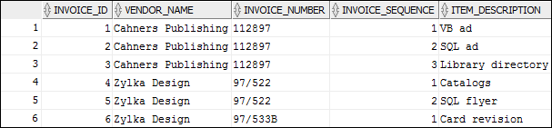
Second Normal Form (2NF)
2NF Rule:
1NF is true (✔️)
Primary key is not composite
All non-key fields depend on the primary key

Slide 31
Second Normal Form (2NF)
2NF Rule:
1NF is true (✔️)
Primary key is not composite (✔️)
All non-key fields depend on the primary key (✔️)

Slide 32
Third Normal Form (3NF)
VendorId | VendorName
1 | Cahners Publishing
2 | Zylka Design
InvoiceNumber | InvoiceId | VendorId
11287 | 1 | 1
97/522 | 2 | 2
97/533B | 3 | 2
InvoiceId | InvoiceSequence | ItemDescription
1 | 1 | VB ad
1 | 2 | SQL ad
1 | 3 | Library Directory
2 | 1 | Catalogs
2 | 2 | SQL flyer
3 | 1 | Card revision
3NF Rule:
2NF is true (✔️)
Changing one non-key field should not require changing any other non-key field (✔️)

Slide 33
Is this model 3NF?
VendorId (PK)
VendorName
VendorAddressStreetAndNumber
VendorAddressCity
VendorAddressState
VendorAddressZip
VendorPhoneNumber
VendorFaxNumber
VendorWebAddress
VendorSalesContactFirstName
VendorSalesContactastName
VendorSalesContactExt
VendorARContactFirstName
VendorARContactLastName
VendorARContactExt
Vendor
InvoiceId(PK)
VendorId(FK)
InvoiceNumber
InvoiceDate
InvoiceTerms
InvoiceTotal
Invoice
Item part number
ItemLineNumber(PK)
InvoiceId(FK)
ItemQuantity
ItemDescription
ItemUnitPrice
ItemExtension
Item
1
issues
N
1
Includes
N

Slide 34
Perhaps now it Is more 3NF …
Vendor_Id (PK)
Vendor_Name
Vendor_Address1
Vendor_Address2
Vendor_City
Vendor_State
Vendor_Zip_Code
Vendor_Phone
Vendor_Contact_First_Name
Vendor_Contact_Last_Name
Default_Terms_Id
Default_Account_Number
Vendors
Invoice_Id(PK)
Vendor_Id(FK)
Invoice_Number
Invoice_Date
Invoice_Total
Payment_Total
Credit_Total
Terms_Id
Invoice_Due_Date
Payment_Date
Invoices
InvoiceId(PK, FK)
InvoiceSequence (PK)
Account_Number (FK)
Line_Item_Amt
Line_Item_Description
Invoice_Line_Items
1
issues
N
1
Includes
N
N
AccountsFor
1
Account_Number (PK)
Account_Description
General_Ledger_Accounts

Slide 35
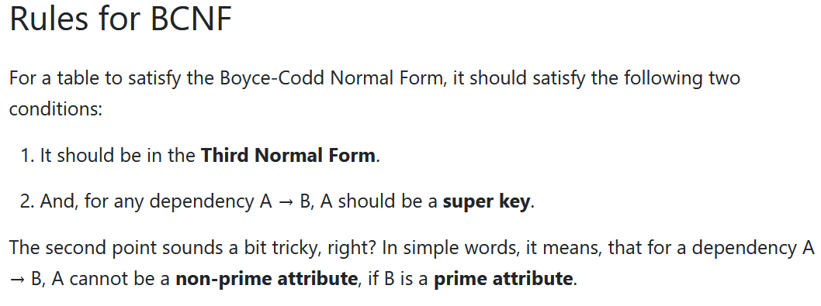
Boyce-Codd Normal Form (BCNF)
Id | First Name | Last Name | StreetNumberAndAddress | Zip
001 | John | Doe | 123 Main St. | 78723
002 | Jane | Doe | 123 Valley Rd. | 78723
003 | John | Doe | 123 Valley Rd | 10514
A non-key column can’t be dependent on another non-key column
Id | First Name | Last Name | StreetNumberAndAddress | City | State | Zip
001 | John | Doe | 123 Main St. | Austin | TX | 78723
002 | Jane | Doe | 123 Valley Rd. | Austin | TX | 78723
003 | John | Doe | 123 Valley Rd | Chappaqua | NY | 10514
Get a better example here…
City | State | Zip
Austin | TX | 78723
Chappaqua | NY | 10514

Slide 36
Fourth Normal Form (4NF)
A table must not have more than one multivalued dependency, where the primary key has a one to many relationship to non-key columns
CId | Course Name | Department
001 | MIS325 | IROM
002 | MIS304 | IROM
003 | AP326 | Accounting
CId | Course Name | Department | Instructor
001 | MIS325 | IROM | Anand
002 | MIS304 | IROM | Smith
003 | AP326 | Accounting | Joshi
CId | Course Name | Instructor
001 | MIS325 | Anand
002 | MIS304 | Smith
003 | AP326 | Joshi

Slide 37
Remaining Normal Forms
Fifth Normal Form (5NF) – The model is split into smaller and smaller structures until all redundancy is removed.
Domain Key Normal Form (DKNF of 6NF) – Every constraint on the relationship is dependent only on key constraints, where a domain is the set of allowable values for a column.

Slide 38
Pros and cons of normalization
Pros
Reduce redundant data – leads to increased data integrity
Increase the number of questions that can be asked
Segment sensitive data
Grant granular permission
Cons
More difficult for business to understand
Queries require joins
Update performance can be reduced
Insert performance?

Slide 39
When to denormalize data?
In real-world settings, sometimes it is necessary to denormalize data and accept the disadvantages of data redundancy.
When this is done, it is primarily for 2 reasons:
Performance – Data is combined in one table so that transactional applications that are reading and updating the data do not need to perform any joins.
Analysis – Data is combined in one table so that the data can be analyzed by individuals without knowledge of the structure of the data.

Slide 40
Break out teams

Slide 41
Back to our six-step process
Step 1: Identify the data elements (entities and attributes)
Step 2: Subdivide each element into its smallest useful components
Step 3: Define the entities (tables) and attributes (columns)
Step 4: Identify and define relationships between the entities and translated these to primary and foreign keys
Step 5: Review whether the data structure is normalized
Step 6: Identify the indexes

Slide 42

Next class
Topic Focus: Physical design and DDL
Read articles and review videos posted on Canvas
Come prepared to discuss and work in teams

Slide 43
https://utexas.qualtrics.com/jfe/form/SV_cG7Si64sNJrTVYO
What questions may I answer before we conclude …
All questions are good questions

Slide 44
Appendix

Slide 45
Accounts Payable Example

Slide 46
Step 1: Identify the data elements
Space for attributes
Vendor
Space for attributes
Invoice
Space for attributes
Item

Slide 47
Step 1: Identify the data elements
VendorName
VendorAddress
VendorPhoneNumber
VendorFaxNumber
VendorWebAddress
VendorSalesContactName
VendorSalesContactExt
VendorARContactName
VendorARContactExt
Vendor
InvoiceNumber
InvoiceDate
InvoiceTerms
InvoiceTotal
Invoice
Item part number
ItemQuantity
ItemDescription
ItemUnitPrice
ItemExtension
Item

Slide 48
Step 2: Subdivide data elements
VendorName
VendorAddressStreetAndNumber
VendorAddressCity
VendorAddressState
VendorAddressZip
VendorPhoneNumber
VendorFaxNumber
VendorWebAddress
VendorSalesContactFirstName
VendorSalesContactLastName
VendorSalesContactExt
VendorARContactFirstName
VendorARContactLastName
VendorARContactExt
Vendor
InvoiceNumber
InvoiceDate
InvoiceTerms
InvoiceTotal
Invoice
Item part number
ItemQuantity
ItemDescription
ItemUnitPrice
ItemExtension
Item

Slide 49
Step 4: Relationships & Keys
VendorName
VendorAddressStreetAndNumber
VendorAddressCity
VendorAddressState
VendorAddressZip
VendorPhoneNumber
VendorFaxNumber
VendorWebAddress
VendorSalesContactFirstName
VendorSalesContactastName
VendorSalesContactExt
VendorARContactFirstName
VendorARContactLastName
VendorARContactExt
Vendor
InvoiceNumber
InvoiceDate
InvoiceTerms
InvoiceTotal
Invoice
Item part number
ItemQuantity
ItemDescription
ItemUnitPrice
ItemExtension
Item

Slide 50
Step 4: Relationships & Keys
VendorName
VendorAddressStreetAndNumber
VendorAddressCity
VendorAddressState
VendorAddressZip
VendorPhoneNumber
VendorFaxNumber
VendorWebAddress
VendorSalesContactFirstName
VendorSalesContactastName
VendorSalesContactExt
VendorARContactFirstName
VendorARContactLastName
VendorARContactExt
Vendor
InvoiceNumber
InvoiceDate
InvoiceTerms
InvoiceTotal
Invoice
Item part number
ItemQuantity
ItemDescription
ItemUnitPrice
ItemExtension
Item
1
Issues
N
1
Includes
N

Slide 51
Step 4: Relationships & Keys (Primary)
VendorName
VendorAddressStreetAndNumber
VendorAddressCity
VendorAddressState
VendorAddressZip
VendorPhoneNumber
VendorFaxNumber
VendorWebAddress
VendorSalesContactFirstName
VendorSalesContactastName
VendorSalesContactExt
VendorARContactFirstName
VendorARContactLastName
VendorARContactExt
Vendor
InvoiceNumber
InvoiceDate
InvoiceTerms
InvoiceTotal
Invoice
Item part number
ItemQuantity
ItemDescription
ItemUnitPrice
ItemExtension
Item
1
issues
N
1
Includes
N

Slide 52
Step 4: Relationships & Keys (Primary)
VendorId (PK)
VendorName
VendorAddressStreetAndNumber
VendorAddressCity
VendorAddressState
VendorAddressZip
VendorPhoneNumber
VendorFaxNumber
VendorWebAddress
VendorSalesContactFirstName
VendorSalesContactastName
VendorSalesContactExt
VendorARContactFirstName
VendorARContactLastName
VendorARContactExt
Vendor
InvoiceId(PK)
InvoiceNumber
InvoiceDate
InvoiceTerms
InvoiceTotal
Invoice
Item part number
ItemLineNumber(PK)
ItemQuantity
ItemDescription
ItemUnitPrice
ItemExtension
Item
1
issues
N
1
Includes
N

Slide 53
Step 4: Relationships & Keys (Foreign)
VendorId (PK)
VendorName
VendorAddressStreetAndNumber
VendorAddressCity
VendorAddressState
VendorAddressZip
VendorPhoneNumber
VendorFaxNumber
VendorWebAddress
VendorSalesContactFirstName
VendorSalesContactastName
VendorSalesContactExt
VendorARContactFirstName
VendorARContactLastName
VendorARContactExt
Vendor
InvoiceId(PK)
InvoiceNumber
InvoiceDate
InvoiceTerms
InvoiceTotal
Invoice
Item part number
ItemLineNumber(PK)
ItemQuantity
ItemDescription
ItemUnitPrice
ItemExtension
Item
1
issues
N
1
Includes
N

Slide 54
Step 4: Relationships & Keys (Foreign)
VendorId (PK)
VendorName
VendorAddressStreetAndNumber
VendorAddressCity
VendorAddressState
VendorAddressZip
VendorPhoneNumber
VendorFaxNumber
VendorWebAddress
VendorSalesContactFirstName
VendorSalesContactastName
VendorSalesContactExt
VendorARContactFirstName
VendorARContactLastName
VendorARContactExt
Vendor
InvoiceId(PK)
VendorId(FK)
InvoiceNumber
InvoiceDate
InvoiceTerms
InvoiceTotal
Invoice
Item part number
ItemLineNumber(PK)
InvoiceId(FK)
ItemQuantity
ItemDescription
ItemUnitPrice
ItemExtension
Item
1
issues
N
1
Includes
N

